Slide 1
Data Engineering Bootcamp
Capstone Project-1
Presented By: Mihir Kumar

Slide 2
Business Objectives
Exploratory Data Analysis of provided Data Set.
Using the data set to come up with meaningful insights.
Using Machine Learning to come up with the various reasons for the employees leaving the company.

Slide 3








Technology Stack Used
MySQL (to create database)
Linux Commands
Sqoop (Transfer data from MySQL Server to HDFS/Hive)
HDFS (to store the data)
Hive (to create database)
Impala (to perform the EDA)
SparkSQL (to perform the EDA)
SparkML (to perform model building)

Slide 4
Data Set Used
Various CSV used:
Departments
Department Managers
Department Employees
Employees
Salaries
Titles

Slide 5
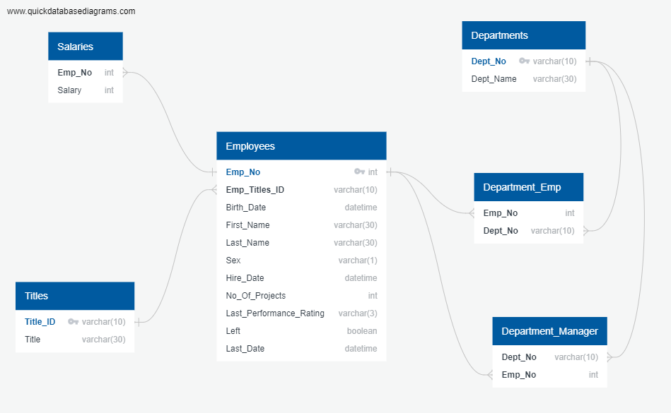
E-R Diagram

Slide 6
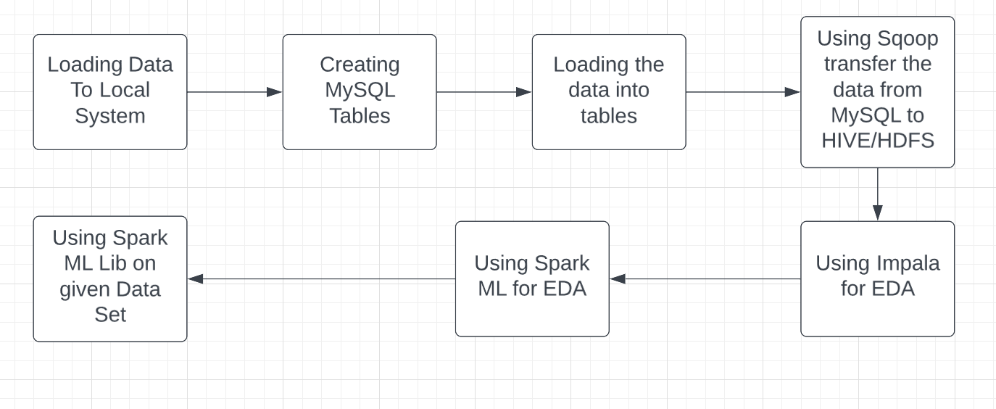
Pipeline Architecture

Slide 7
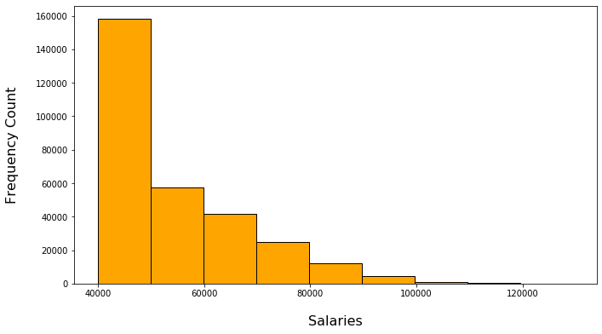
Outputs
Salary Distribution among the Employees.

Slide 8
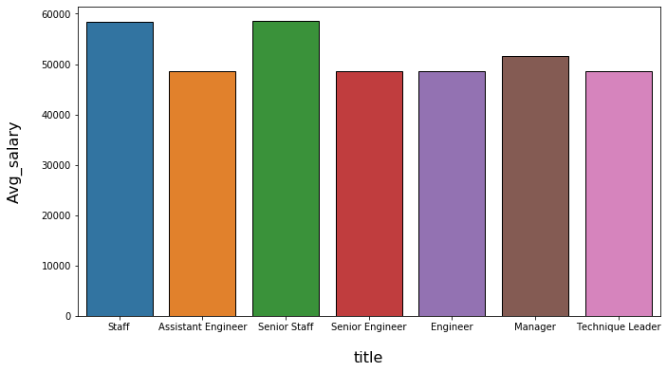
Average Salary Title Wise.

Slide 9
Title Distribution among the Employees.

Slide 10
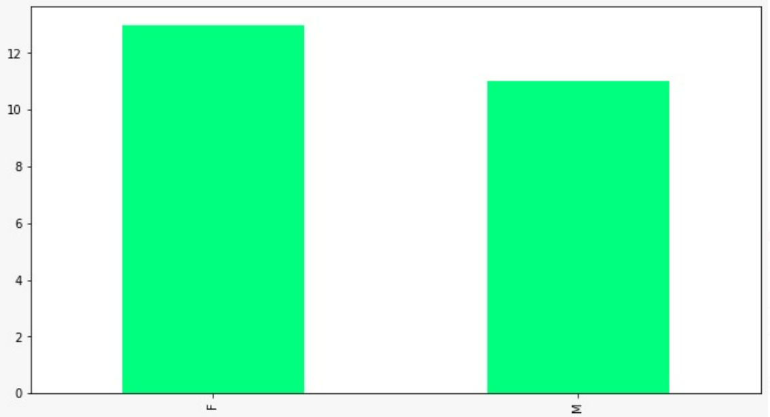
Number of Male v/s Female Managers.

Slide 11
ML Outputs
Accuracy | 0.9016284345853289
Error | 0.09837156541467107
Precision | 0.8129338340527907
Recall | 0.9016284345853289
F1 | 0.8549870408622282

Slide 12
Challenges Faced
Importing Data from Local to MySQL.
Data Transfer using SQOOP.
Using ML Lib for Machine Learning.

Slide 13
Steps Ahead
The analysis can be used by the company to access its employee retention.
The analysis can be used to find out the reasons why employees are leaving the company.
The reasons found out may be used to rectify the problems.

Slide 14
Thank You

